Slide 1
Chapter 10
How to make predictions with a linear regression model

Slide 2
Objectives
Applied
Use scatter plots or heatmaps to identify correlations.
Use the corr() method to identify correlations.
Use Scikit-learn to create and validate a linear regression model and to use the model to make predictions.
Use Seaborn to plot the predicted values and the residuals of a linear regression model.
Use the Seaborn lmplot() method to create and plot these types of linear regression models: simple, logistic, polynomial, and lowess.
Use the Seaborn residplot() method to plot the residuals for linear regression models.

Slide 3
Objectives (continued)
Knowledge
Describe a linear regression model.
Distinguish between a simple linear regression and a multiple linear regression in terms of independent and dependent variables.
Describe two ways to identify the correlations between the variables in a DataFrame.
In general terms, describe the procedure for creating, validating, and using a regression model.
Describe regression residuals.

Slide 4
Types of predictive models
Model | Description
Classification model | Categorizes data into predefined groups based on historic data.
Clustering model | Identifies similarities in data and creates groups based on these similarities.
Outliers model | Identifies anomalies relative to historic data.
Forecast model | Makes predictions about numeric data based on historic data.
Time series model | Makes predictions about numeric data based on historic data with time as a factor.

Slide 5
Real-world applications of predictive analysis
Industry | Usage
Finance | Credit scores, loan applications, risk analysis, fraud detection.
Healthcare | Personalized healthcare, patient deterioration detection, readmission prevention.
Manufacturing | Maintenance prediction, product quality prediction.
Marketing | Product recommendation, customer satisfaction analysis.
Sports | Individual performance prediction, team performance prediction.
Entertainment | Content curation, content adoption prediction.

Slide 6
An introduction to regression analysis
A linear regression model is a conceptual model that uses an equation to predict an unknown value called a dependent variable based on the values of one or more known values called independent variables.
A simple linear regression uses only one independent variable, and a multiple linear regression uses two or more independent variables.

Slide 7
Real-world linear regression examples
Predict revenue (DV) based on advertising budget (IV).
Predict patient readmission rate (DV) given factors like hemoglobin count (IV), prior admissions (IV), blood pressure (IV), current medications (IV), and age (IV).
Predict household energy consumption (DV) given factors like the number of people living there (IV), the size of the house (IV), the energy consumption of surrounding houses (IV), and past energy consumption (IV).
Predict the odds of a sports team winning a game (DV) given factors like who they are playing (IV), the current season record (IV), any injured players (IV), and where the game is played (IV).

Slide 8
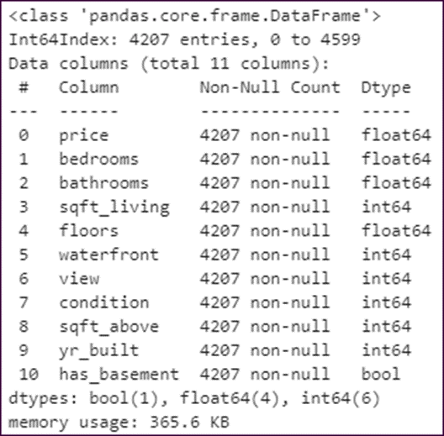
The columns of the Housing dataset
housing.info()

Slide 9
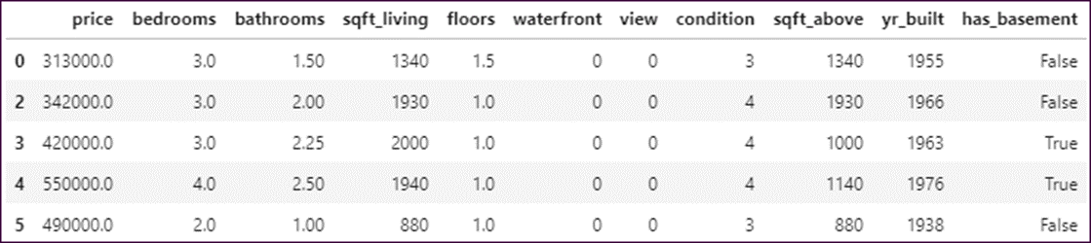
The first five rows of the Housing dataset
housing.head()

Slide 10
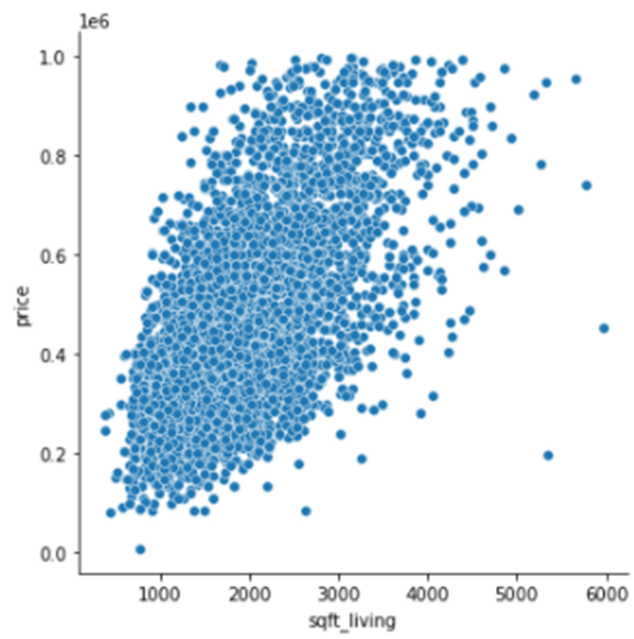
A scatter plot that shows two variables that have a correlation
sns.relplot(data=housing, x='sqft_living', y='price')

Slide 11
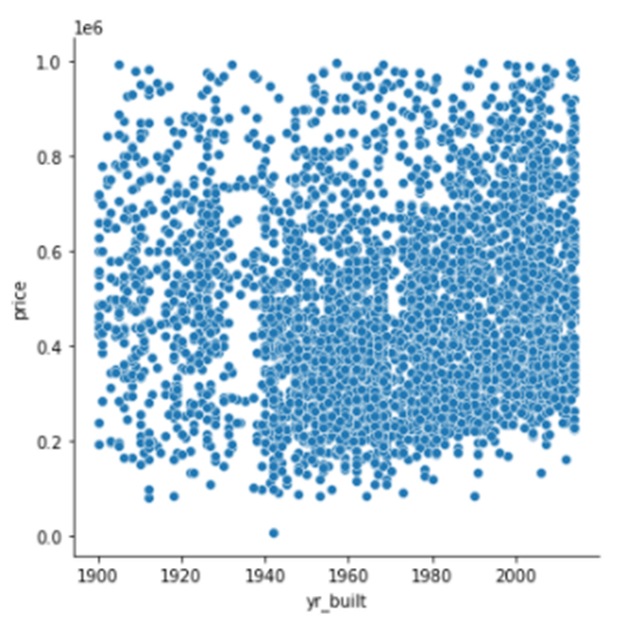
A scatter plot that shows two variables that don’t have a correlation
sns.relplot(data=housing, x='yr_built', y='price')

Slide 12
The Seaborn pairplot() method
Method | Description
pairplot(params) | Creates a grid of plots for all possible pairs of the specified variables.
Parameters of the pairplot() method
Parameter | Description
kind | The default is scatter. Other values include ‘kde’, ‘hist’, or ‘reg’.
diag_kind | The type of plot for the diagonal. Possible values include ‘hist’, ‘kde’, or None. The default is ‘hist’.
x_vars, y_vars | The x or y variables to use. By default, it uses all variables.
corner | If False (the default), show all plots. If True, don’t show the plots to the right of the diagonal.

Slide 13
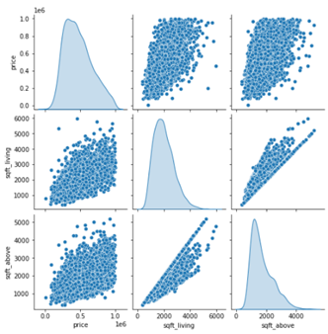
How to use the pairplot() method
sns.pairplot(data=housing,
y_vars=['price','sqft_living','sqft_above'],
x_vars=['price','sqft_living','sqft_above'],
diag_kind='kde')

Slide 14
How to interpret the r-value
r-value | Correlation type | r-value | Correlation type
1.00 | Perfect positive | -1.00 | Perfect negative
.90 to .99 | Very strong positive | -.90 to -.99 | Very strong negative
.70 to .89 | Strong positive | -.70 to -.89 | Strong negative
.50 to .69 | Moderate positive | -.50 to -.69 | Moderate negative
.30 to .49 | Weak positive | -.30 to -.49 | Weak negative
.01 to .30 | Negligible positive | -.01 to -.30 | Negligible negative
0.00 | No correlation | 0.00 | No correlation

Slide 15
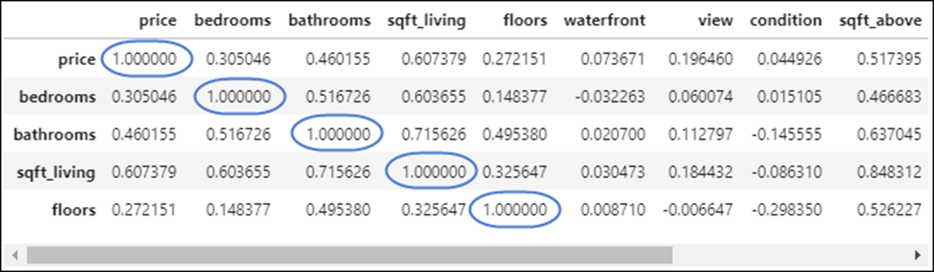
How to use the Pandas corr() method
housing.corr().head()

Slide 16
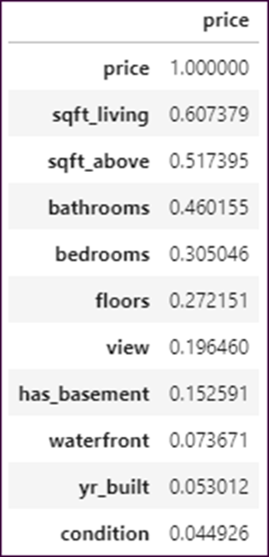
How to filter the results of the corr() method
housing.corr()[['price']].sort_values(by='price',
ascending=False)

Slide 17
The Seaborn heatmap() method
Method | Description
heatmap(params) | Creates a heatmap.
Parameters of the heatmap() method
Parameter | Description
cmap | The color map to use. Includes the built-in maps named ‘Reds’, ‘Greens’, ‘Blues’, and so on.
vmin, vmax | The minimum and maximum value used to determine the color shading.
annot | If set to True, each cell is annotated with its numeric value.
cbar | If set to False, the color bar isn’t displayed.
fmt | The format string to apply to numbers when they’re annotated.

Slide 18
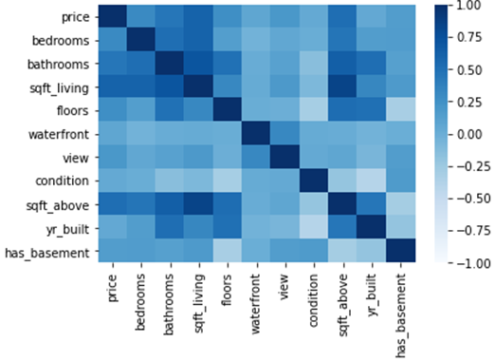
How to plot correlation data with a heatmap
sns.heatmap(data=housing.corr(), cmap='Blues',
vmin=-1.0, vmax=1.0)

Slide 19
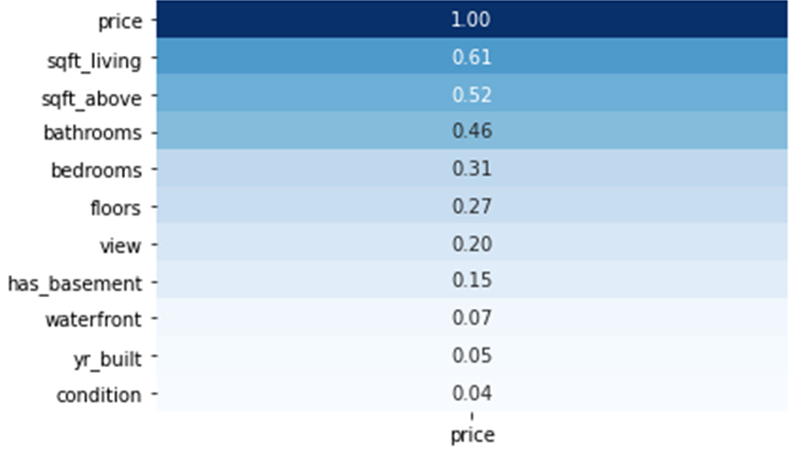
How to condense a heatmap
sns.heatmap(data=housing.corr()[['price']].sort_values(
by='price', ascending=False), annot=True, cmap='Blues',
cbar=False, fmt=f'.2f')

Slide 20
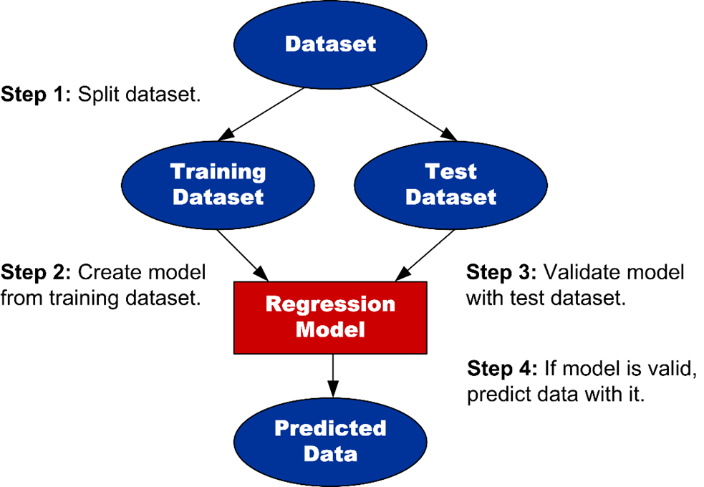
The procedure for creating, testing, and using a regression model

Slide 21
How to import sklearn’s train_test_split() function
from sklearn.model_selection import train_test_split
The train_test_split() function
Function | Description
train_test_split(params) | Splits a dataset into training and test datasets. Must include one or more positional parameters that identify the data, followed by any optional named parameters.

Slide 22
Parameters of the train_test_split() function
Parameter | Description
test_size | The percentage of the dataset that will make up the test dataset. Should be a float between 0.0 and 1.0. The default is 0.25.
train_size | The percentage of the dataset that will make up the training dataset. Should be a float between 0.0 and 1.0.
shuffle | If True (the default), the data is shuffled before splitting.
random_state | If set to an integer value, the shuffling can be reproduced. Otherwise, the shuffling is random.

Slide 23
How to import sklearn’s LinearRegression class
from sklearn.linear_model import LinearRegression
Methods of the LinearRegression object
Method | Description
fit(x,y) | Fits the linear regression model using a sample of x and y values.
score(x,y) | Returns the R² value for the prediction.
predict(x) | Predicts the y values given a set of x values.

Slide 24
How to create, validate, and use a linear regression model
Import the function and class that you need from Scikit-learn
from sklearn.model_selection import train_test_split
from sklearn.linear_model import LinearRegression
Step 1: Split the data into the training and test datasets
x_train, x_test, y_train, y_test = train_test_split(
housing[['sqft_living']], housing[['price']],
test_size=0.33, random_state=42)
Step 2: Create the model from the training dataset
linearModel = LinearRegression()
linearModel.fit(x_train, y_train)
Step 3: Validate the model with the test dataset
linearModel.score(x_test, y_test)
=================================
0.35072654653322344

Slide 25
How to create, validate, and use a linear regression model (continued)
Step 4: Use the model to make predictions
y_predicted = linearModel.predict(x_test)
y_predicted
=========================================
array([[355333.11742787],
[545363.47687159],
[466838.5349527 ],
...,
[325493.63949869],
[415012.07328623],
[394595.58838732]])

Slide 26
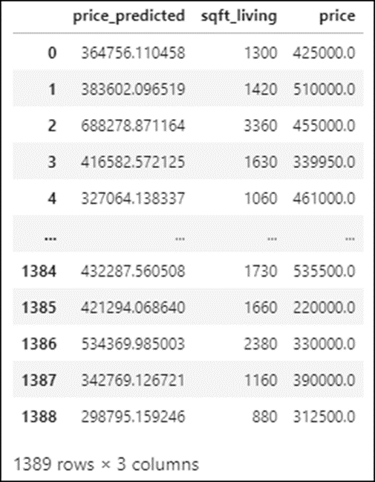
The predicted prices vs. the test prices

Slide 27
How to prepare the data for plotting
Step 1: Put the predicted values in a DataFrame
predicted = pd.DataFrame(y_predicted,
columns=['price_predicted'])
Step 2: Combine the test data and the predicted data
combined = predicted.join([x_test.reset_index(drop=True),
y_test.reset_index(drop=True)])
Step 3: Melt the price and price_predicted columns into a single column
melted = pd.melt(combined, id_vars=['sqft_living'],
value_vars=['price','price_predicted'],
var_name='price_type',
value_name='price_value')

Slide 28
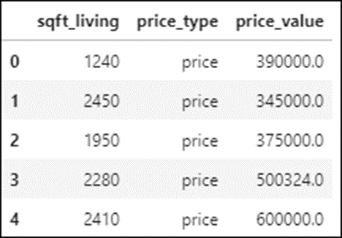
The DataFrame with the prepared data
melted.head()

Slide 29
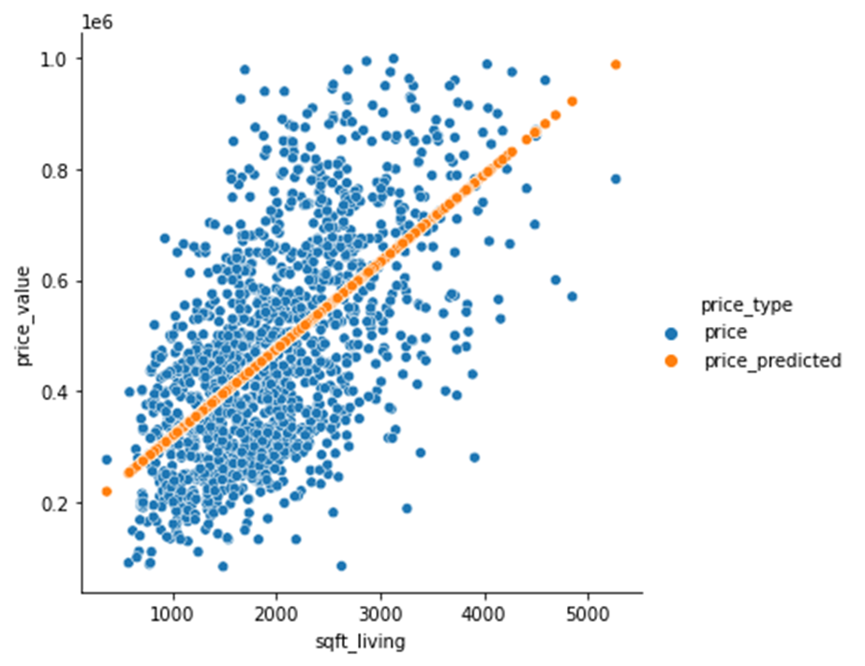
How to plot the test and training data
sns.relplot(data=melted, x='sqft_living', y='price_value',
hue='price_type')

Slide 30
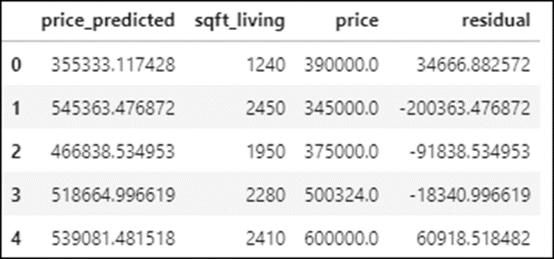
How to calculate residuals
combined['residual'] = combined.price - combined.price_predicted
combined.head()

Slide 31
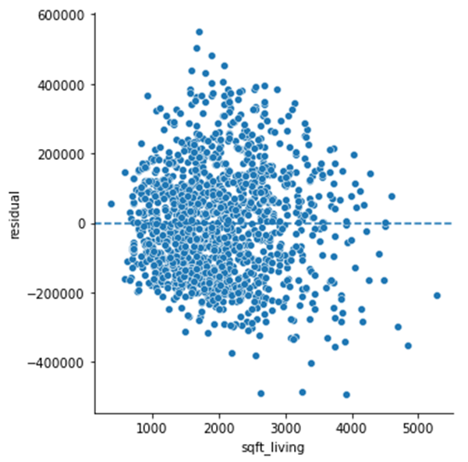
How to plot the residuals
g = sns.relplot(data=combined, x='sqft_living', y='residual')
# draw a horizontal line where the y axis is 0
for ax in g.axes.flat:
ax.axhline(0, ls='--') # use dashed line style

Slide 32
Types of linear regressions
Type | Description
simple | Fits a straight line to a dataset using one variable as a predictor as shown earlier in this chapter.
multiple | Fits a line to a dataset using several variables as predictors as shown in the next chapter.
logistic | Measures the probability of a dichotomous variable based on a predictor variable.
robust | Reduces the effect of outliers.
polynomial | Uses a polynomial equation to model the relationship for the predictor variable.
lowess | Uses the locally weighted scatterplot smoothing (lowess) technique to create a polynomial regression.

Slide 33
A Seaborn method for plotting linear regression models
Method | Description
lmplot(params) | Uses a linear regression model to create a scatter plot with a regression line fitted to it.
Parameters of the lmplot() method
Parameter | Description
scatter | If True (the default), displays the scatter plot.
fit_reg | If True (the default), displays the regression line.
line_kws | A dictionary of parameters for the regression line.
scatter_kws | A dictionary of parameters for the display of the scatter plot.

Slide 34
Parameters of the lmplot() method (cont.)
Parameter | Description
markers | The type of marker that’s used by the scatter plot. Possible values include c for circle, s for square, and d for diamond.
x_bins | The number of bins for datapoints on the x-axis.
logistic | If True, creates a logistic regression.
robust | If True, creates a robust regression.
lowess | If True, creates a lowess regression..
order | The degree of the polynomial equation to use when fitting the line. This creates a polynomial regression.

Slide 35
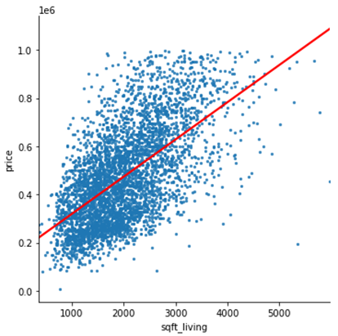
A simple linear regression
sns.lmplot(data=housing, x='sqft_living', y='price', ci=None,
scatter_kws={'s':5}, line_kws={'color':'red'})

Slide 36
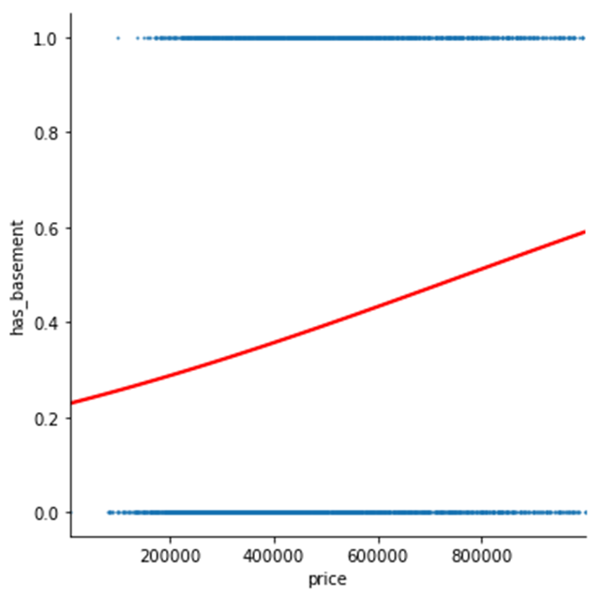
A logistic regression
sns.lmplot(data=housing, x='price', y='has_basement', ci=None,
scatter_kws={'s':1}, line_kws={'color':'red’}, logistic=True)

Slide 37
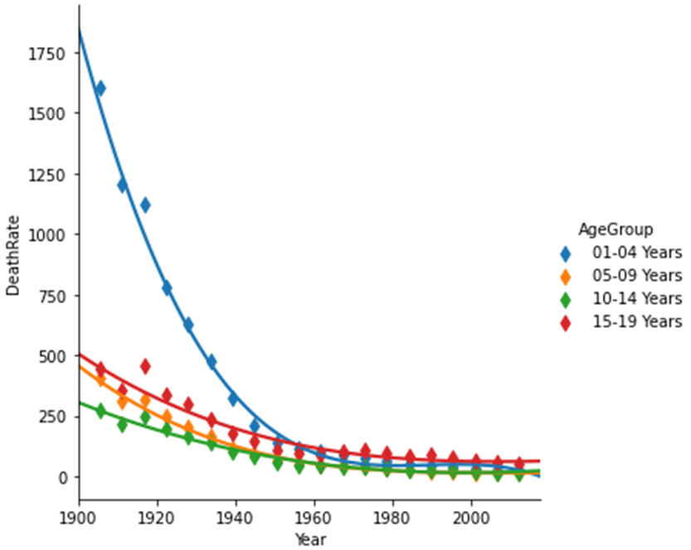
A polynomial regression
sns.lmplot(data=mortality_data, x='Year', y='DeathRate',
hue='AgeGroup', ci=None, markers='d', x_bins=20,
order=3)

Slide 38
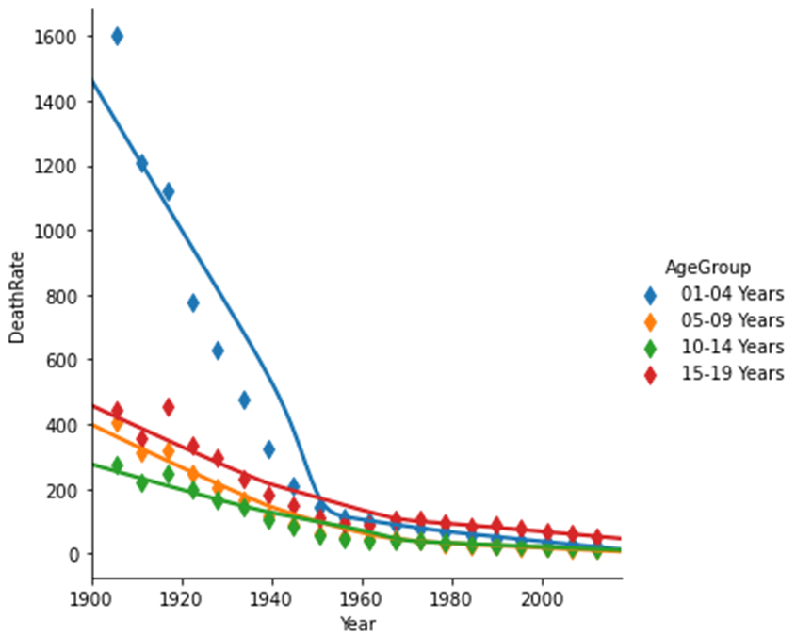
A lowess regression
sns.lmplot(data=mortality_data, x='Year', y='DeathRate',
hue='AgeGroup', ci=None, markers='d', x_bins=20,
lowess=True)

Slide 39
The Seaborn residplot() method for plotting residuals
Method | Description
residplot(params) | Creates a plot of the residuals of a regression. Returns an Axes object.
Parameters of the residplot() method
Parameter | Description
lowess | If True, create the residuals for a lowess regression.
order | The order of the polynomial equation that’s used to create the residuals.
robust | If True, create the residuals for a robust regression.

Slide 40
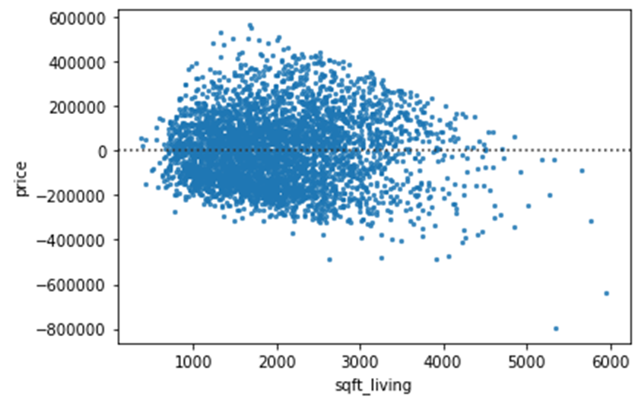
The residuals for a simple linear regression
sns.residplot(data=housing, x='sqft_living', y='price',
scatter_kws={'s':5})

Slide 41
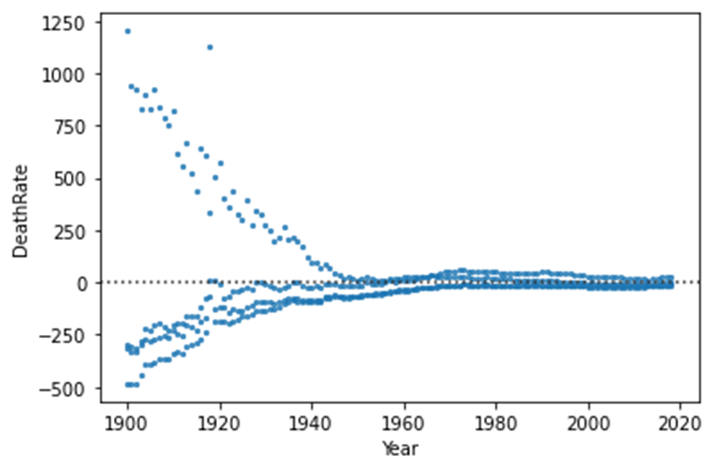
The residuals for a polynomial regression
sns.residplot(data=mortality_data, x='Year', y='DeathRate',
order=3, scatter_kws={'s':5})

